Slide 1
natural numbers, Primes and Multi-Layered Perceptrons
Nathan hall
Rohan Saha

Slide 2
Background
Ensemble algorithms tend to outperform single, well crafted, algorithms.
Geometric representations of Natural numbers can influence/dictate the algebraic description of subsets of Natural numbers.

Slide 3
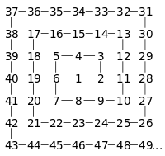
Ulam Spiral

Slide 4
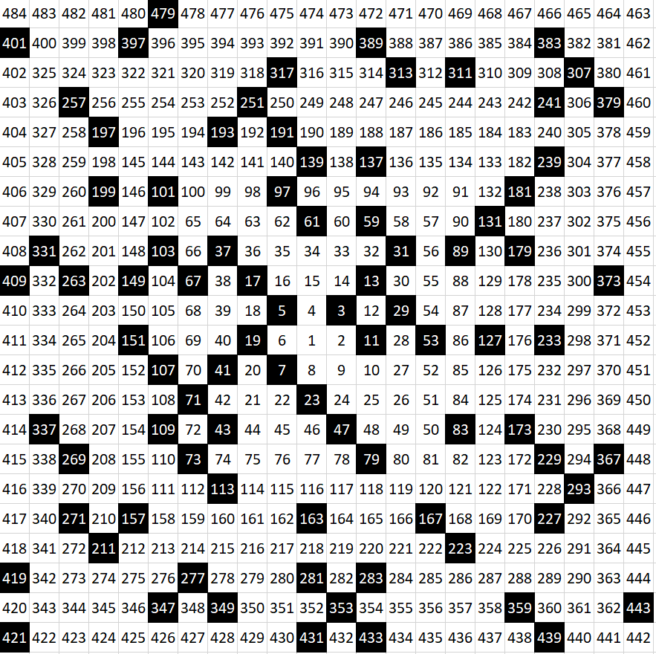
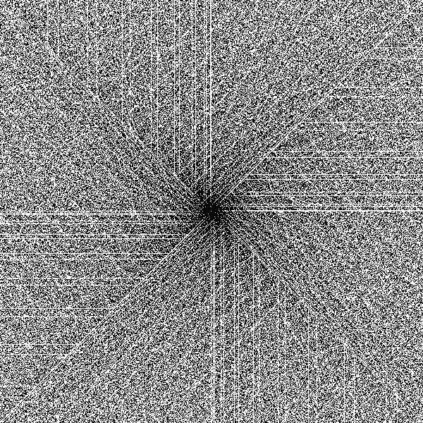
Ulam Primes

Slide 5
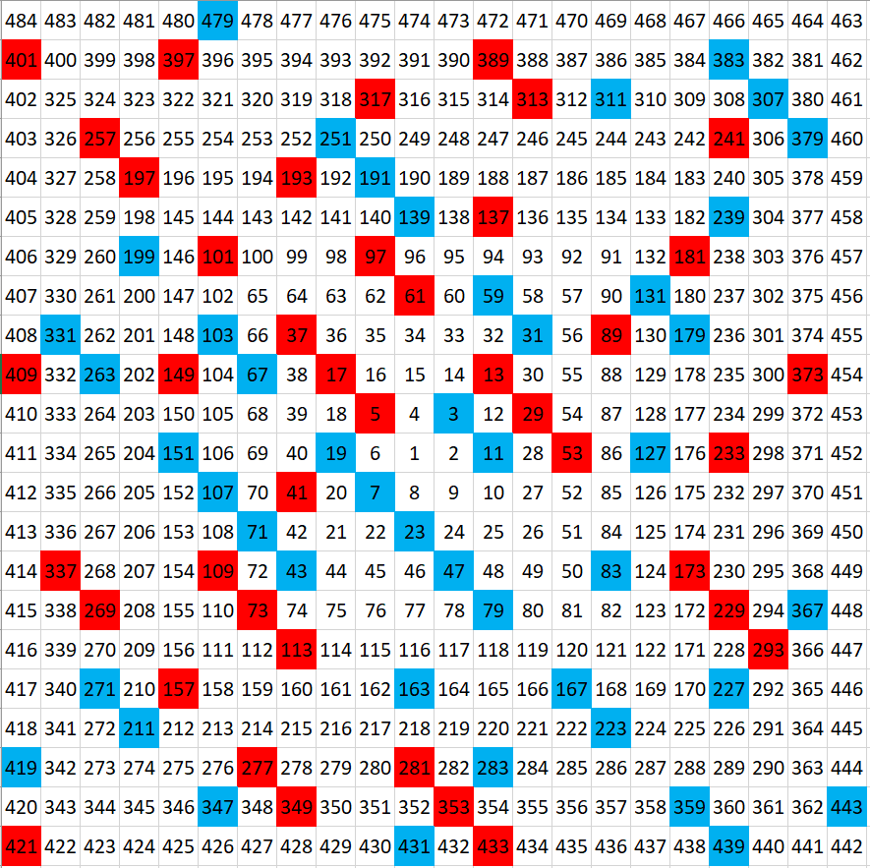
Ulam Gaussian Primes & Composites

Slide 6
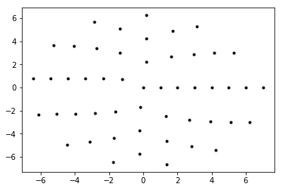
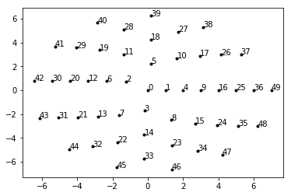
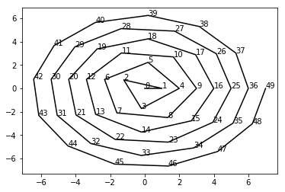
Sack’s Spiral

Slide 7
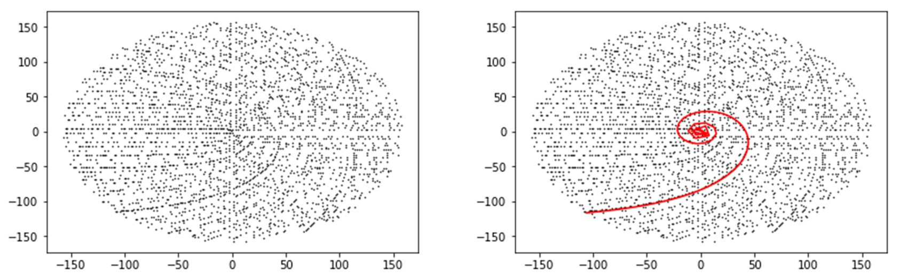
Sack’s Primes

Slide 8
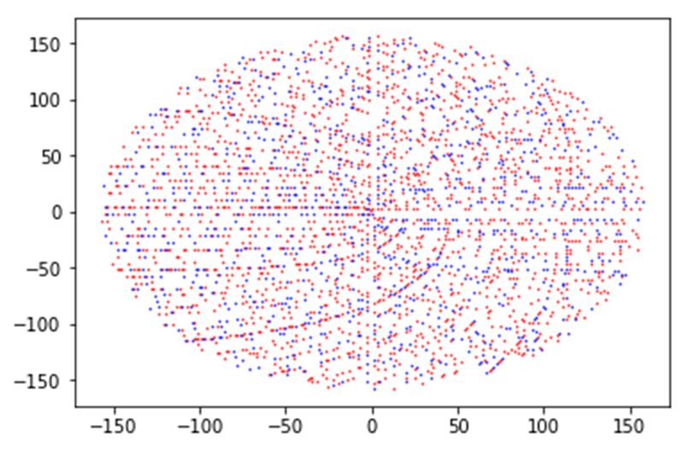
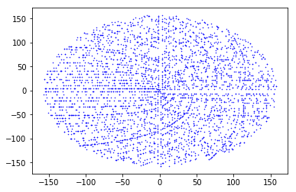
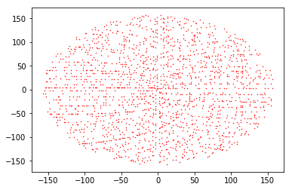

Slide 9
Big Picture
Attempt to predict the classification of a number, without knowing the number itself, by strictly looking at its attributes.
The attributes are the ensemble of results to several primality/composite tests.

Slide 10
Common Tests to Find Characteristics of Natural Numbers
Fibonacci Numbers - Selfridge’s Conjecture Lucas Numbers - Baillie-PSW Exponentiation - Fermat’s Little Theorem (FLT), Selfridge, Baillie-PSW Mod 4 - Gaussian Factorization Mod 5 - Selfridge Mod 6 - General Arithmetic Property Mod p - Wilson, Baillie-PSW, FLT

Slide 11

General Arithmetic Properties
All primes, > 3, are of the form 6n $±$ 1, where n is a Natural number.
Ex. Let n = 1. Then:
6n – 1 = 5
6n + 1 = 7

Slide 12

Wilson’s Theorem
(p – 1)! $≡$ -1 mod p
Ex. Let p = 5. Then:
(5 – 1)! (mod 5)
= 4! (mod 5)
= 4 * 3 * 2 (mod 5)
= 24 (mod 5)
$≡$ 4 (mod 5)
$≡$ -1 (mod 5)

Slide 13

Selfridge Conjecture
Given p = 2k + 1 and p $≡$ $±$ 2 (mod 5), if $2^{p−1}$ $≡$ 1 (mod p) and $f_{p+1}$ $≡$ 0 (mod p), then p is prime. *$f_{n}$ is the nth Fibonacci number.
Ex. Let p = 7, then: $2^{7−1}=2^{6}=64≡1$ (mod 7) and $f_{7+1}=f_{8}=21≡0$ (mod 7). Hence, 7 is prime
This is still an open problem

Slide 14
Baillie-PSW (Pomerance, Sulfridge, Wagstaff)
Same as Selfridge’s Conjecture, but substitute Lucas numbers for Fibonacci numbers.

Slide 15
Fermat’s Little Theorem
Fermat’s Little Theorem:
a^(n-1) congruent 1 mod n

Slide 16
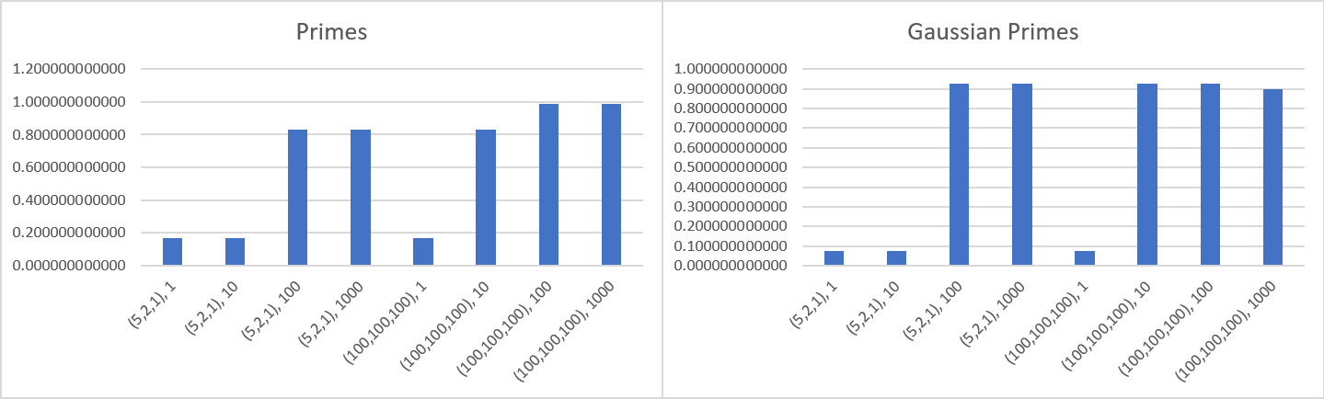

Slide 17
Future Attributes to Analyze
More bases for Fermat’s Little Theorem Set of Coprimes Members of Curves and Intersections of Sack’s Spiral Diagonals of Ulam’s Spiral Attributes of Lenstra’s Elliptic Curve Factorization

Slide 18
Goals of Future Work
To see if a set of n attributes can achieve a high accuracy of predicting prime/compositeness of a given number.
Find a novel set of attributes to create a new sieve algorithm.
Find a novel set of attributes to find primes/pseudoprimes.
Find if a subset of primes can be reliably identified. Find a correlation between different spiral, or spiral like, organizations of natural numbers and the probability of being prime. i.e. prime density If so, attempt to use Genetic Programming to see if progress can be made on the Twin Prime Conjecture.

